Slide 1
Containers & DevOps
Daniel Wang – Cloud Solutions Architect

Slide 2
Session agenda
Containers & Kubernetes introduction
Deployment strategies
Tools of the trade

Slide 3
What is a container?
Containers = operating system virtualization
Traditional virtual machines = hardware virtualization
OS
Application
VM
VM
VM
Applications
Container
Container
Container
App
App
App
Kernel
OS
OS
OS
OS
Hardware
Hardware
Windows Server containers: maximum speed and density
Hyper-V containers: isolation plus performance
OS
Container
Container
Container
Applications
Container
Container
Container
Kernel
Kernel
Kernel
Kernel
Hardware
Hyper-V

Slide 4
Virtualization versus containerization?
Virtual machine
Container
Application XYZ
Application
App dependencies
Dependencies
Guest OS
Image
C
C
C
C
C
VM
VM
VM
VM
VM
VM
Dependency 1
Dependency 2
Hypervisor 2
Docker Engine
Hypervisor 1
Host OS
Host OS
Hardware
Hardware
Hardware
Type 1
Type 2
Virtualization
Containerization

Slide 5
The benefits of using containers
Agility
Ship apps faster
Portability
Easily move workloads
Density
Achieve resource efficiency
Rapid scale
Scale easily to meet demand

Slide 6




The benefits of using containers
Any OS
Anywhere
Any app
Any language
Java
Linux
On-premises
Monolith
.Net
Python
Windows
Cloud
Microservice
Node

Slide 7
The container advantage
Containerized environment
Migrate containers and their dependencies to underutilized VMs for improved density and isolation
VM
VM
Con.
Con.
Decommission unused resources for efficiency gains and cost savings
Con.
Con.
Container is lighter weight and faster to scale dynamically
Docker Engine
Host OS
Hardware

Slide 8
Benefits of a container architecture
Containers are a packaging mechanism in which applications are abstracted from the environment in which they run. This allows container-based applications to be deployed easily and consistently, regardless of whether the target environment is a private data center, the public cloud, or even a developer’s personal laptop.
Repeatable and productive
Container-hosted code is reusable and portable (Build, Ship, and Run).
Containers are consistent across development, test and production.
Containers can be defined in smaller units than a VM, lowering cost and enabling apps to scale more granularly.
Fast and efficient
Fast and agile app deployment with DevOps built-in and instant startup.
Containers don’t require a separate operating system and use less resources.
An application deployed in a container may perform better than when the same app is deployed in a VM.
Technology/platform agnostic
Build it once, run it anywhere: containers run on any cloud, without changes to code.
Containers support all frameworks and technology stacks.
Notes:
Benefits of a container architecture are plentiful, including:
Working with containers is repeatable and more productive.
Containers are reusable, portable (“Build, Ship, and Run”) and consistent across development, test and production.
Containers are fast and more efficient than VMs – they enable fast and agile app deployment and instant startup.
Since containers do not require a separate operating system, they use less resources and the tend to be more cost-effective.
Containers are platform independent - build it once and run it anywhere: containers run on any cloud, and even on premises, without changes.
Containers support all frameworks and technology stacks.

Slide 9
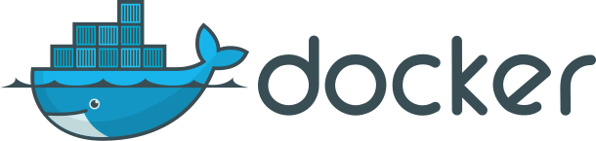
What is ?
An open source container runtime
Mac, Windows and Linux support
# The world’s simplest Dockerfile
$ cat Dockerfile
FROM scratch
COPY hello /
CMD ["/hello"]
# Let’s create a docker image “tagged” hello-world
$ docker build –t hello-world .
# And run it…
$ docker run hello-world

Slide 10
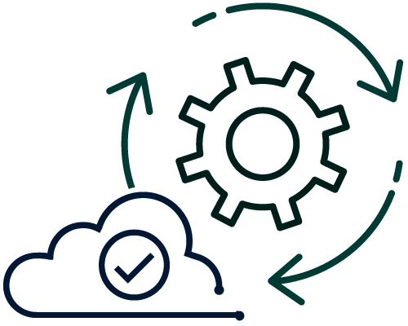
From traditional systems to portfolio of modern apps
App
Container
App
Existing/New Applications
Containerize Applications
Each host often runs 8 containers at a time¹
Microservices
Seconds to deploy, churns 12x faster¹
Continuous innovation with DevOps
46x more frequent for code delivery²
Source:
1: Datadog Report: 8 Surprising Facts About Real Docker Adoption; 2: 2017 state of DevOps Report

Slide 11
Microservices: a modern approach for agile & focused teams
Comparing the traditional monolithic application to microservices
Monolithic
Microservices
Large, all-inclusive app
Small, independent services
App
App
App

Slide 12
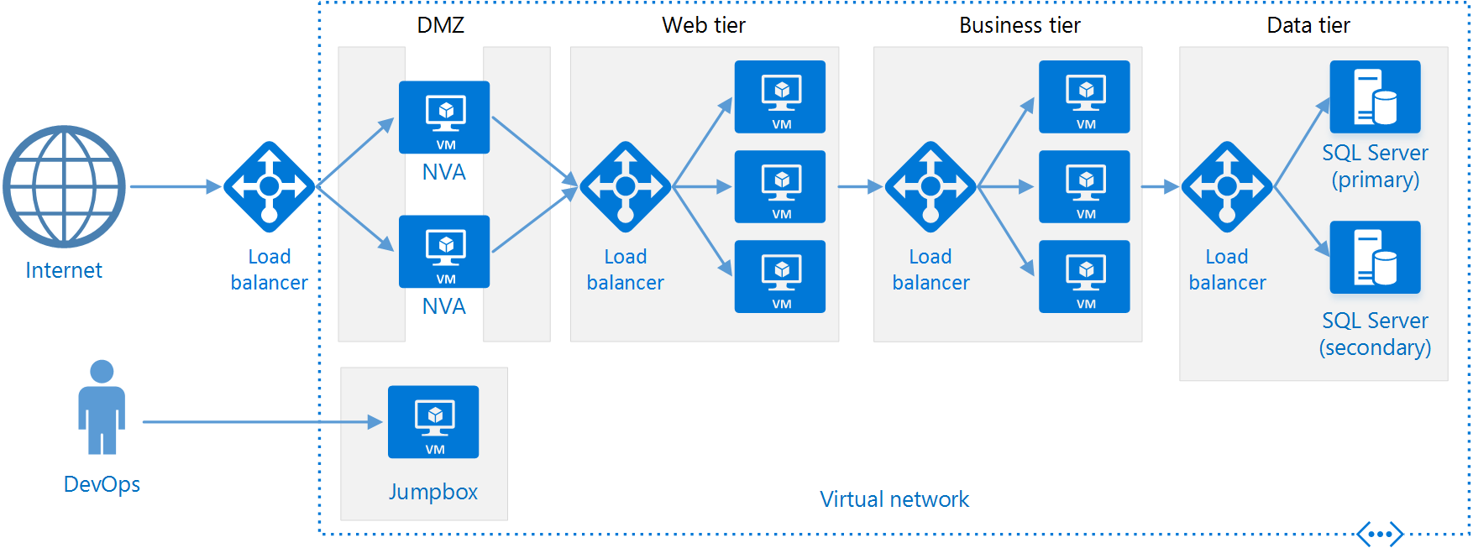
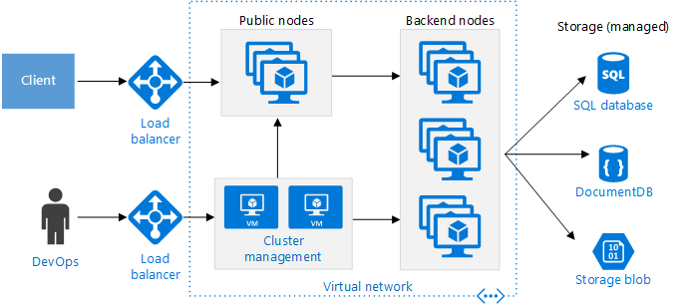
Impact in Software Architecture
N-Tier
Architecture
Microservices
Architecture

Slide 13

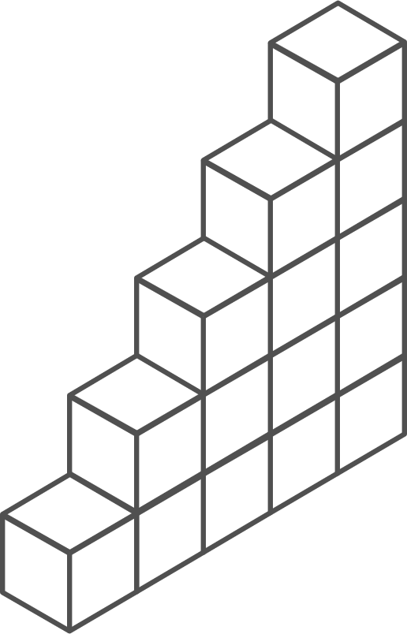
Containers and Kubernetes momentum
“By 2020, more than 50% of enterprises will run mission-critical, containerized cloud-native applications in production.”
Half of container environment is orchestrated.¹
77%
77% of companies² who use container orchestrators choose Kubernetes.
The average size of a container deployment has grown 75% in one year. ¹
Larger companies are leading the adoption.¹
50%
75%
Nearly 50% of organizations¹ running 1000 or more hosts have adopted containers.
1: Datadog report: 8 Surprising Facts About Real Docker Adoption
2: CNCF survey: cloud-native-technologies-scaling-production-applications

Slide 14
Kubernetes: the industry leading orchestrator
Portable
Public, private, hybrid, multi-cloud
Extensible
Modular, pluggable, hookable, composable
Self-healing
Auto-placement, auto-restart, auto-replication, auto-scaling
Notes:
Why did Kubernetes win?
Until about 18 months ago, the container orchestration space was competitive
Docker Swarm, Mesosphere DC/OS, and Kubernetes (among others) were vying for share
The original Azure Container Service reflected this market dynamic, with the choice of orchestrator
Kubernetes began to pull away around the end of 2016
Now, all cloud providers offer a managed Kubernetes service and even Docker and DC/OS integrate Kubernetes
Why?
Community: the project was donated to an OSS foundation (the Cloud Native Computing Foundation) very early on and other major players (notably Red Hat) got involved early, separating it from its Google roots and avoiding lock-in concerns
Container-native: some orchestrators (namely DC/OS) added containers to an existing scheduling technology, which is more flexible but can feel ‘tacked-on’
Built from best practices learned at scale: Kubernetes was inspired by Google’s internal scheduler Borg and incorporated the learnings from it. Other projects (especially Swarm) did not have that maturity.
Why Kubernetes won doesn’t actually matter
Its network effects are now so strong that competitors are struggling to stay relevant even if they are objectively ‘better’ in some respects

Slide 15
Azure Kubernetes Service (AKS)
Simplify the deployment, management, and operations of Kubernetes
Deploy and manage Kubernetes with ease
Scale and run applications with confidence
Secure your Kubernetes environment
Accelerate containerized application development
Work how you want with open-source tools & APIs
Set up CI/CD in a few clicks

Slide 16
Azure Kubernetes Service (AKS) Kubernetes made easy – get the most complete and simple end-to-end experience for seamless Kubernetes lifecycle management on Azure
Deploy and manage Kubernetes with ease Free managed control plane for auto upgrades, patching and self healing Provision with portal, CLI, ARM, or Terraform Full visibility with integrated monitoring and logging | Scale and run applications with confidence Built-in auto scaling Global data center to boost performance and reach Elastically burst from AKS cluster using ACI | Secure your Kubernetes environment Control access through AAD and RBAC Safeguard keys and secrets with Key Vault Secure network communication with VNET and CNI
Accelerate containerized application development Define, install and upgrade apps easily with Helm Automatically scaffold, containerize and deploy with CLI or Visual Studio Rapidly iterate, test and debug microservices using Dev Spaces | Work how you want with open-source tools & APIs 100% open source Kubernetes Take full advantage of services and tools in the ecosystem Easily integrate with SLA-backed Azure services with OSBA | Set up CI/CD in a few clicks Three steps away from a CI/CD pipeline with DevOps Project Work with existing tools such as Jenkins Geo-replicated container registry

Slide 17
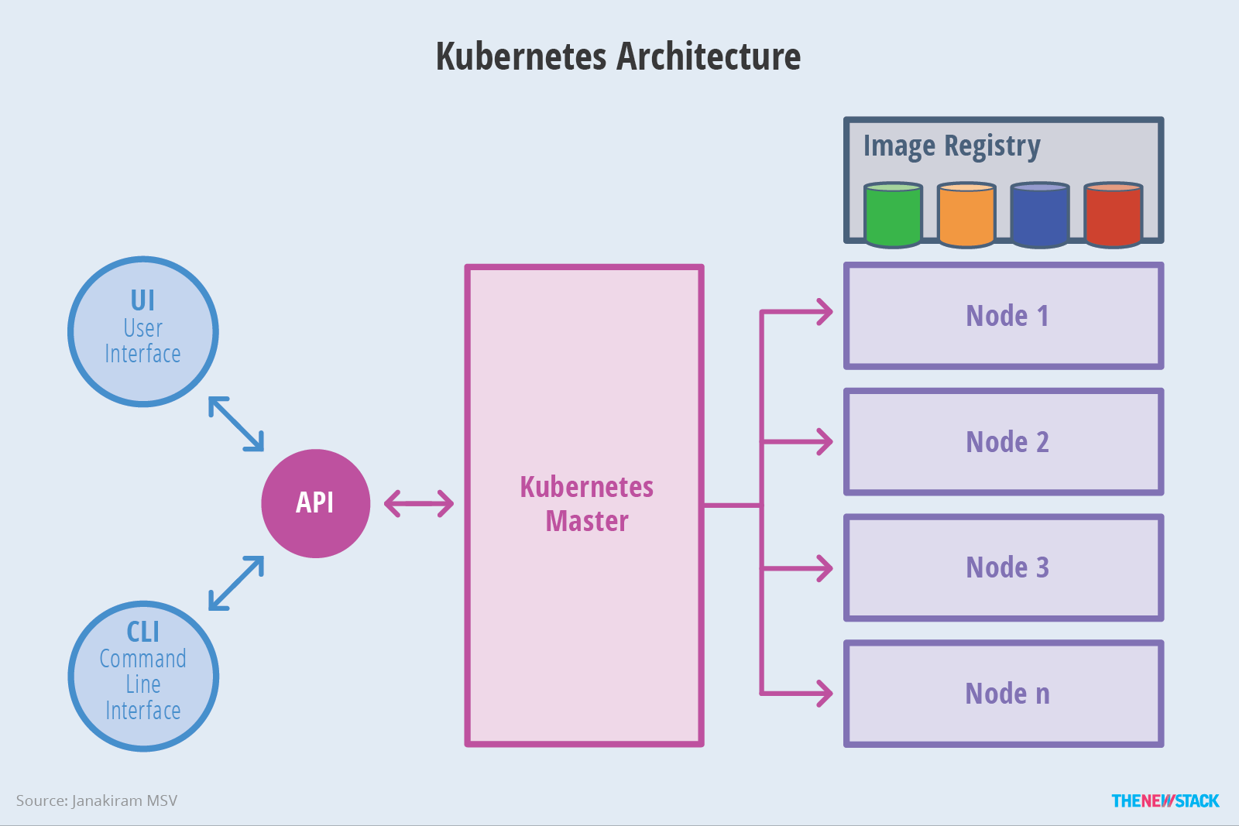
Kubernetes: High Level Architecture

Slide 18
How AKS works
Azure managed control plane
API Server
etcd store
Master Node(s) – self managed
Automated upgrades, patches
High reliability and availability
Easy and secure cluster scaling
Self-healing
API server monitoring
Control plane at no charge
User
App/workload definition
Kubernetes API endpoint
Scheduler
Controller Mgr
Cloud Controller
Schedule pods over private tunnel
Customer VMs
Docker
Docker
Docker
Docker
Notes:
A Kubernetes cluster is typically made up of
Master nodes for system components like the API server, etcd store, and scheduler
Agent nodes for user container workloads
Managing the cluster involves:
Monitoring the API server
Ensuring HA/DR for the etcd store
Safely managing upgrades across Kubernetes versions
Safely scaling the cluster in and out
Patching master and agent VM nodes
And on and on…
This is complex, error-prone, and expensive
A managed service like AKS moves those tasks to the cloud provider

Slide 19
Top scenarios for Kubernetes on Azure
Lift and shift to containers
Microservices
Machine learning
IoT
Cost saving
without refactoring your app
Agility
Faster application development
Performance
Low latency processing
Portability
Build once, run anywhere

Slide 20
Lift and shift to containers
Microservices
Machine learning
IoT
App Modernization without code changes
Deployment
Existing
application
Modernization
Validate
Move applications as is to Azure, but with cost savings
Containers support all frameworks and technology stacks.
Faster app deployment with integrated DevOps tools.
Convert
Publish
VM
Container
Azure Container Registry
Azure Kubernetes Service
CI/CD Pipeline

Slide 21

Lift and shift to containers
Microservices
Machine learning
IoT
Microservices: for faster app development
Monolithic
Microservices
Large, all-inclusive app
Small, independent services
App
App
App
Independent deployments
Improved scale and resource utilization per service
Smaller, focused teams
AKS clusters

Slide 22
Lift and shift to containers
Microservices
Machine learning
IoT
Data Scientist in a box
Azure Kubernetes Service
Quick deployment and high availability
Low latency data processing
Consistent environment across test, control and production
Predictive Web Application
Azure Container Registry
Azure Machine Leaning Model Management Service
Machine Learning Model
Machine Learning Model
Azure Blob Storage
GPU Data Science Virtual Machine

Slide 23


Lift and shift to containers
Microservices
Machine learning
IoT
Scalable Internet of Things solutions
Browser
ACI Instances
Portable code, runs anywhere
Elastic scalability and manageability
Quick deployment and high availability
AKS clusters
IoT devices
IoT Hub
ACI connector
Cosmos DB

Slide 24
What is Cloud-Native?
Immersive and Personal
Cross-Device
Cross-Platform
Intelligent and Data-driven
Application Experience
Cloud-Native
Applications, born in the cloud
Application
Architecture
Containers
Microservices
Orchestrators
Serverless
DevOps

Slide 25

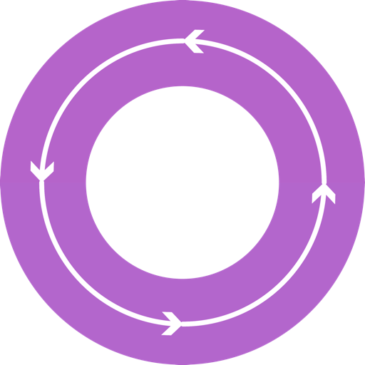



DevOps: the three stage conversation
DEV
OPS
1
People
2
Process
3
Products

Slide 26
What is DevOps?
People. Process. Products.
Build& Test
Deploy
DevOps is the union of people, process, and products to enable continuous delivery of value to your end users.
“
Continuous Delivery
Develop
Operate
”
Donovan Brown
Plan & Track
Monitor & Learn

Slide 27
DevOps w/ Containers
Containers as foundation for DevOps collaboration
Containers allow for an exponentially simpler CI/CD process, by introducing standard build and release artifacts.
The rise of self-healing container orchestration platforms based on containers (Kubernetes) made the use of containers ubiquitous and hassle-free
https://aka.ms/devopscontainers

Slide 28
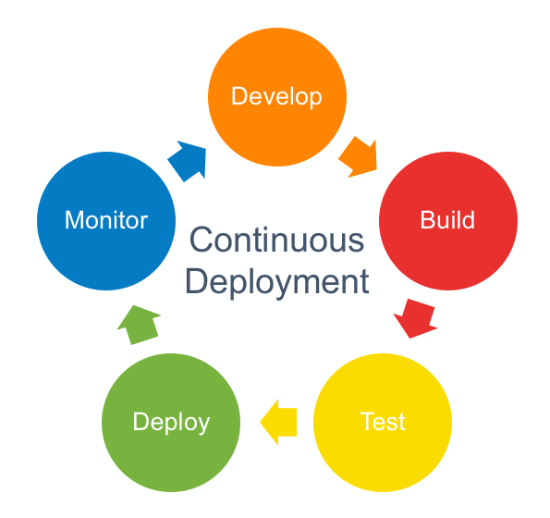
DevOps w/ Containers
The industry standard OCI is the engine behind breakthroughs in application deployment innovations in the last 5 years.
https://aka.ms/devopscontainers

Slide 29
DevOps view of the container advantage
Fast iteration
Agile delivery
Immutability
Cost savings
Efficient deployment
Elastic bursting
For developers
For IT

Slide 30
Software Innovation Synthesis
Containers
(Standardization of the application packaging)
DevOps
(Optimizing how applications are build, delivered and Managed)
Microservices
(Optimizing how applications are composed)
Better Software
Cloud Orchestrators
(Efficient ways to deliver Infrastructure for Applications)

Slide 31
Deployment strategies
Recreate
Rolling update
Blue/green
Canary release
A/B testing
Shadow deploy (feature-flag)
https://container-solutions.com/deployment-strategies/

Slide 32
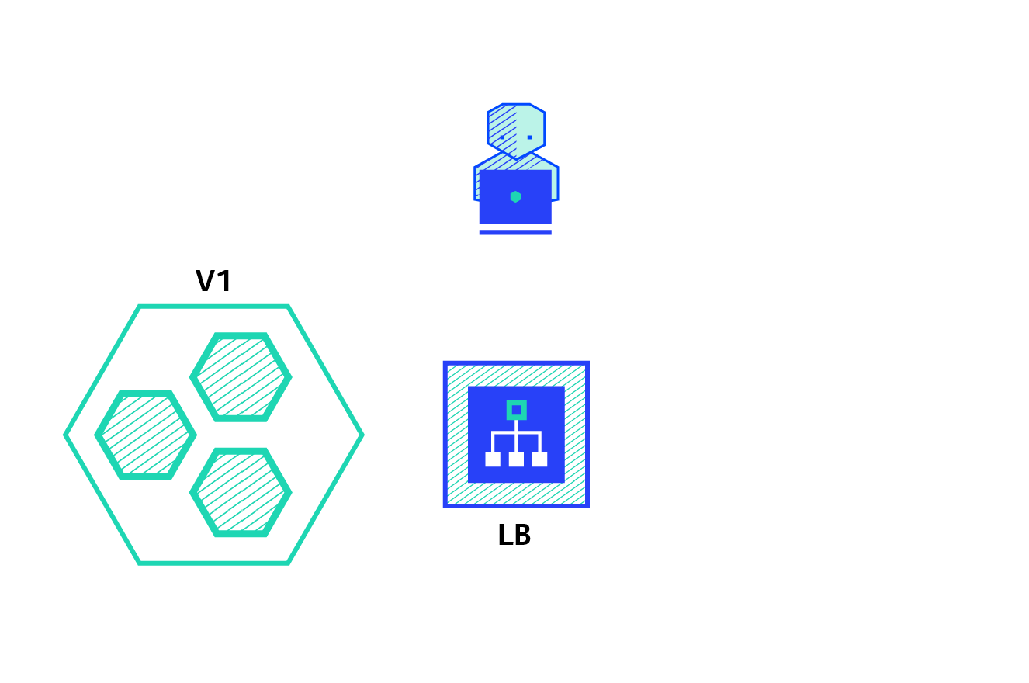
Recreate deployment

Slide 33

Rolling update

Slide 34

Blue/Green

Slide 35

Canary testing

Slide 36
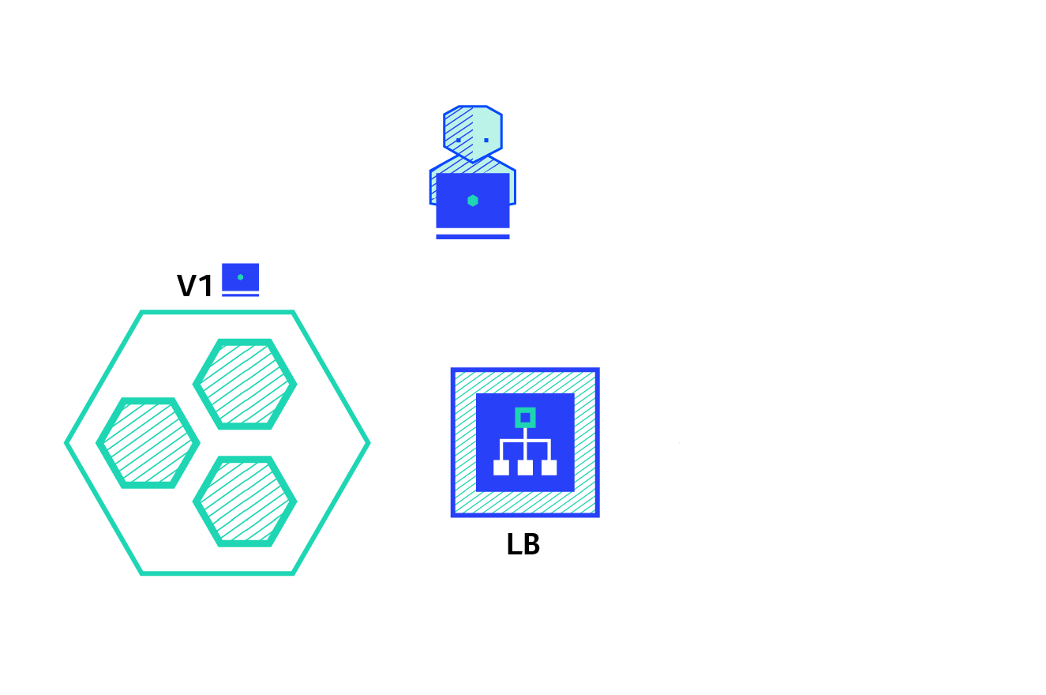
A/B testing

Slide 37

Shadow (feature-flag)

Slide 38
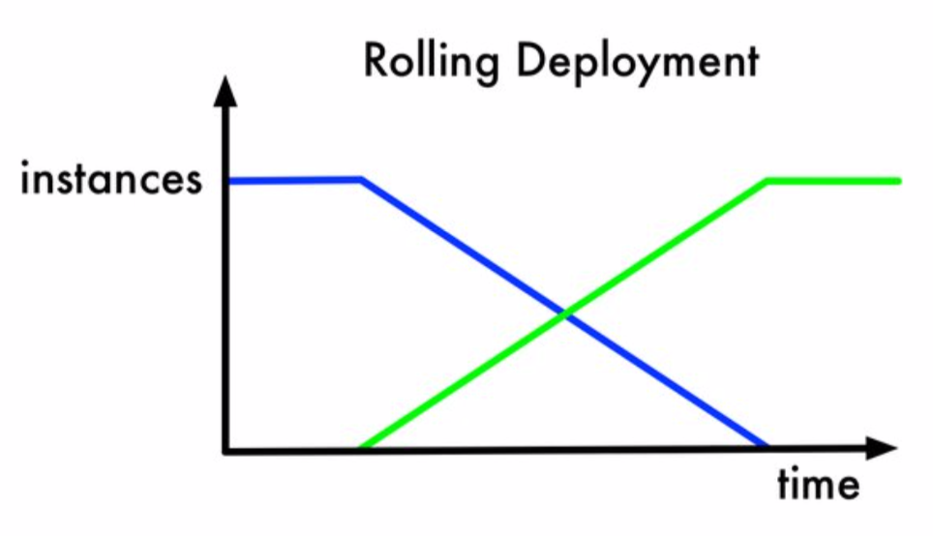
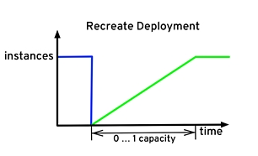
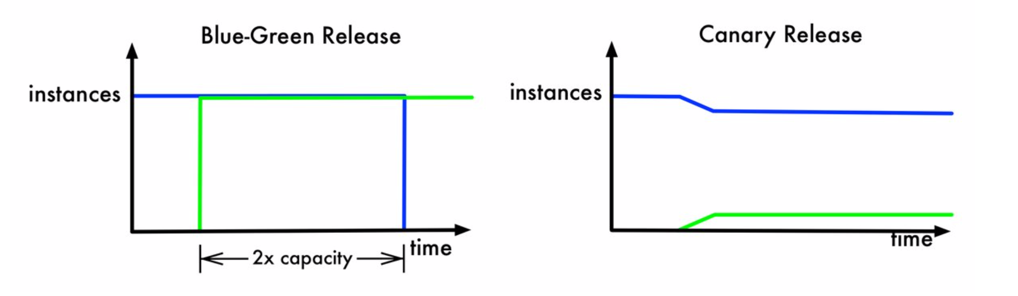
Economics of deployments

Slide 39
Tools of the trade
Helm, ACR, Azure DevOps Projects

Slide 40

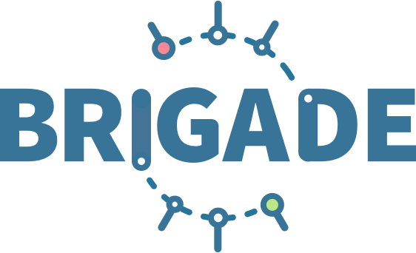


Release automation tools
Azure Container Service (AKS)
Simplifying the Kubernetes experience
Azure Container Instances (ACI)
Azure Container Registry
Open Service Broker API (OSBA)
Streamlined Kubernetes development
The package manager for Kubernetes
Event-driven scripting for Kubernetes
Visualization dashboard for Brigade
Release Automation Tools

Slide 41
Helm
Azure Container Service (AKS)
The best way to find, share, and use software built for Kubernetes
Azure Container Instances (ACI)
Azure Container Registry
Manage complexity
Charts can describe complex apps; provide repeatable app installs, and serve as a single point of authority
Easy updates
Take the pain out of updates with in-place upgrades and custom hooks
Simple sharing
Charts are easy to version, share, and host on public or private servers
Rollbacks
Use helm rollback to roll back to an older version of a release with ease
Open Service Broker API (OSBA)
Release Automation Tools

Slide 42

Helm
Azure Container Service (AKS)
Helm Charts helps you define, install, and upgrade even the most complex Kubernetes application
Azure Container Instances (ACI)
services
ci
db
load balancer
custom
Azure Container Registry
…
Chart.yml
Open Service Broker API (OSBA)
Release Automation Tools
Notes:
Helm
Consider using Helm to manage building and deploying services. Some of the features of Helm that help with CI/CD include:
Organize all of the Kubernetes objects for a particular microservice into a single Helm chart.
Deploy the chart as a single helm command, rather than a series of kubectl commands.
Track updates and revisions, using semantic versioning, along with the ability to roll back to a previous version.
Use templates to avoid duplicating information, such as labels and selectors, across many files.
Manage dependencies between charts.
Publish charts to a Helm repository, such as Azure Container Registry, and integrate them with the build pipeline.
For more information about using Container Registry as a Helm repository, see Use Azure Container Registry as a Helm repository for your application charts.
The diagram on the next page shows a possible CI/CD workflow. This example assumes there is a QA role that is separate from the developer role.
The developer commits a change, which
Triggers the CI pipeline. This pipeline builds the code, runs tests, and builds the container image.
If all gates are passed, the image is pushed the image repository.
When a new version of a service is ready to deploy, a git tag is added, which
Triggers the test CD pipeline, which runs a helm upgrade command to update the test cluster.
If the new version is ready to deploy to production, the QA role manually triggers the production CD pipeline.

Slide 43
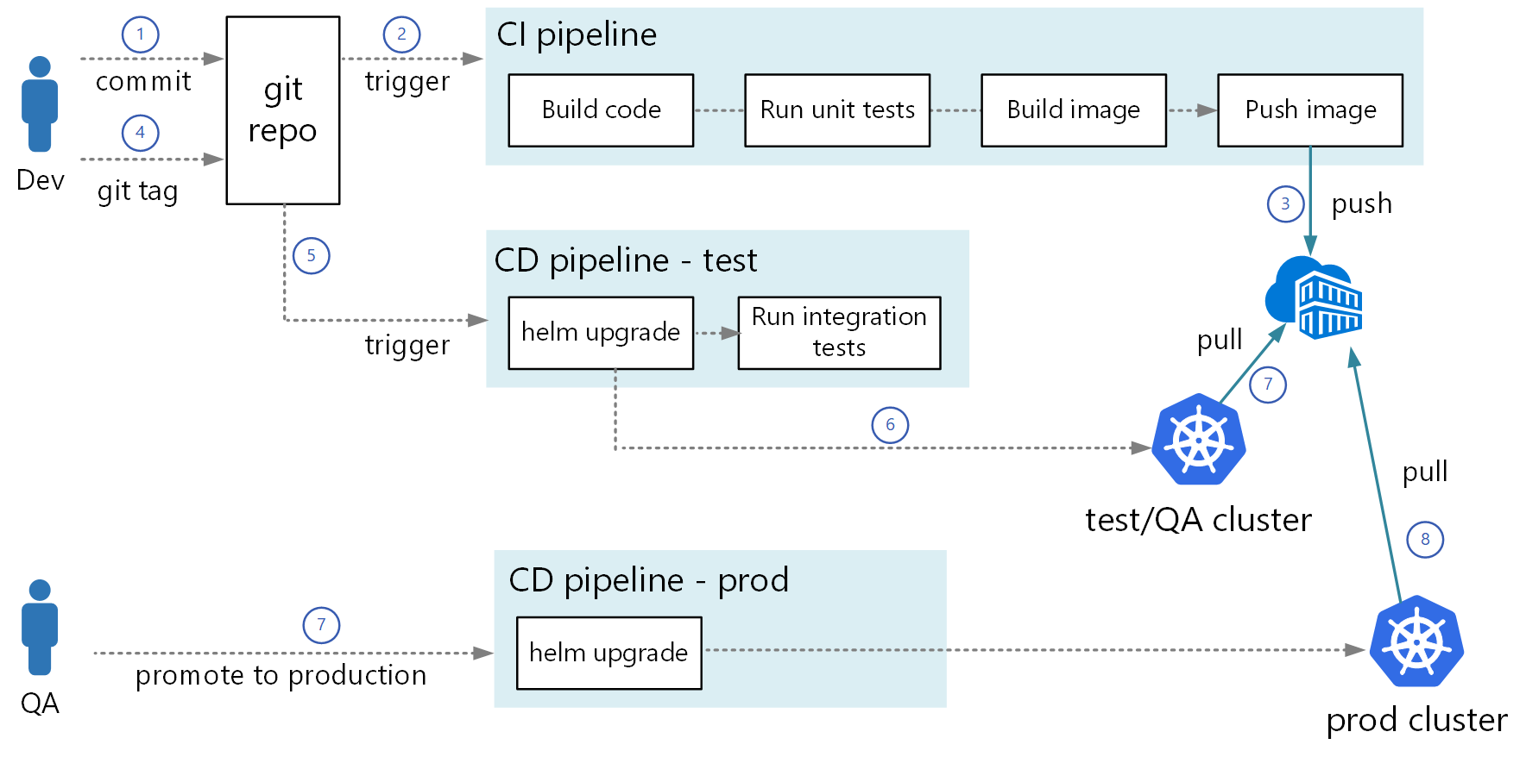
Helm-based CI/CD pipeline
Notes:
Recommended CI/CD practices
Use imagePullPolicy of Always, so that Kubernetes will always pull the latest image from the repository, and not use a cached image. You can enforce this across the cluster by using the AlwaysPullImages admission controller.
Don’t use the ‘latest’ tag for images in a pod spec. Always specify the image version.
Use namespaces in Azure Container Service to organize container images by microservice or development team.

Slide 44
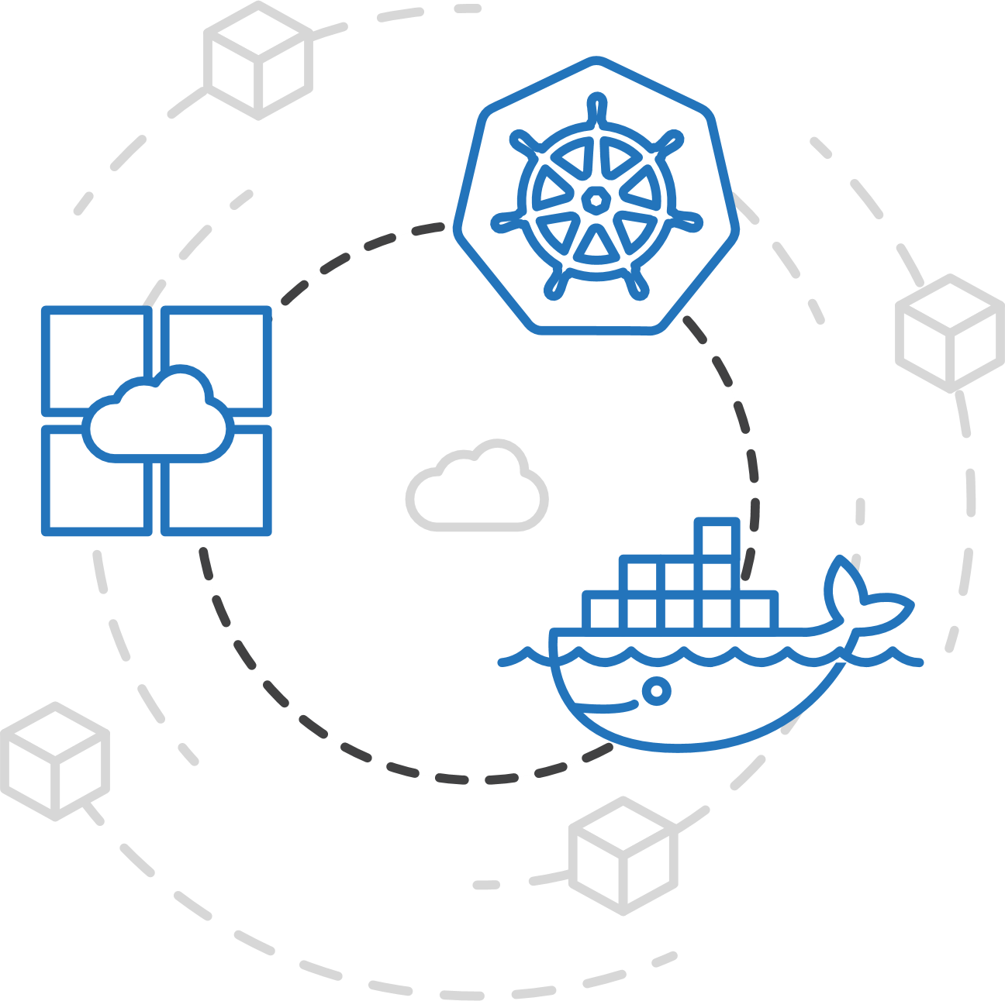
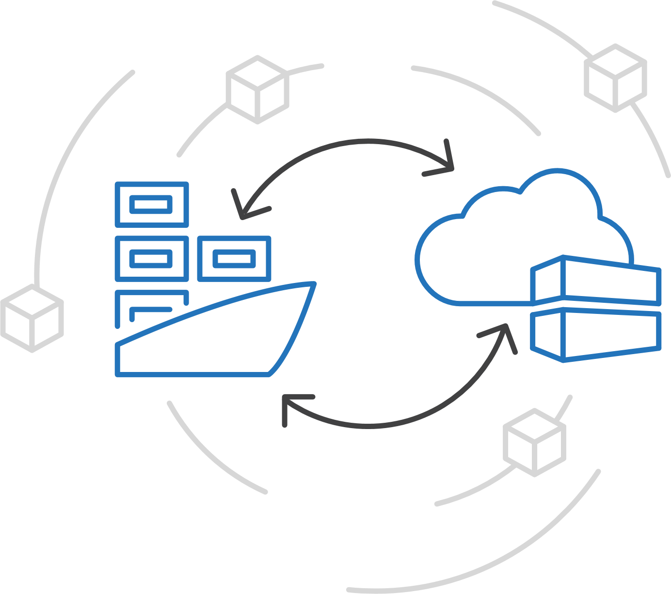
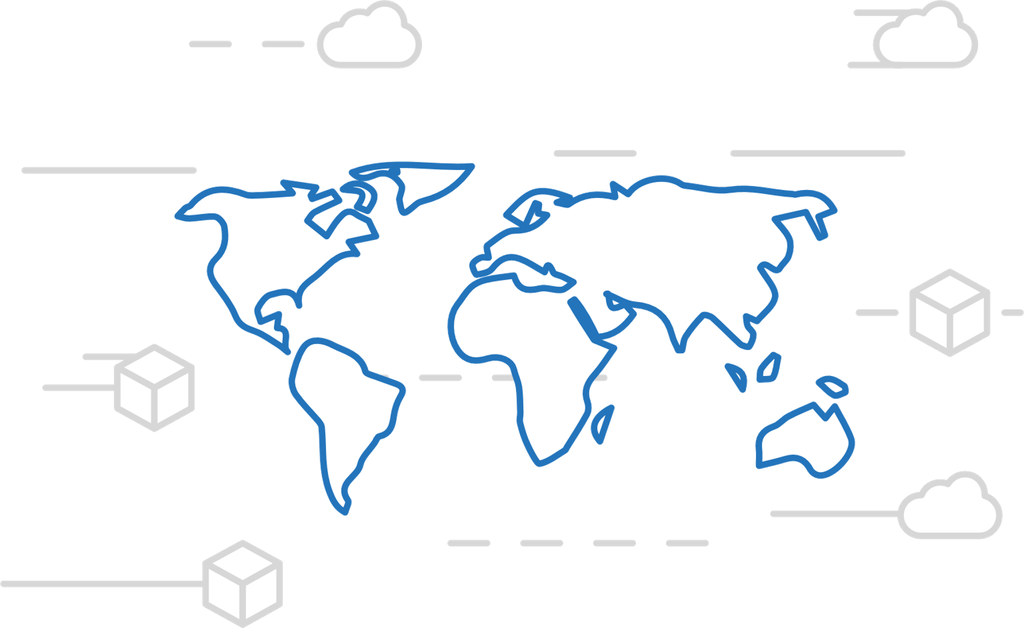
Azure Container Registry
Manage a Docker private registry as a first-class Azure resource
Manage images for all types of containers
Use familiar, open-source Docker CLI tools
Azure Container Registry geo-replication
https://aka.ms/acr/roadmap

Slide 45
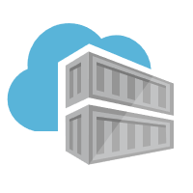
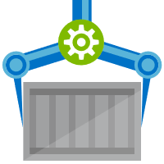
ACR Tasks
A feature of Azure Container Registry
aka.ms/acr/tasks
Providing OS & Framework Patching
Task execution of a graph of containers

Slide 46
Thank you!

Slide 47
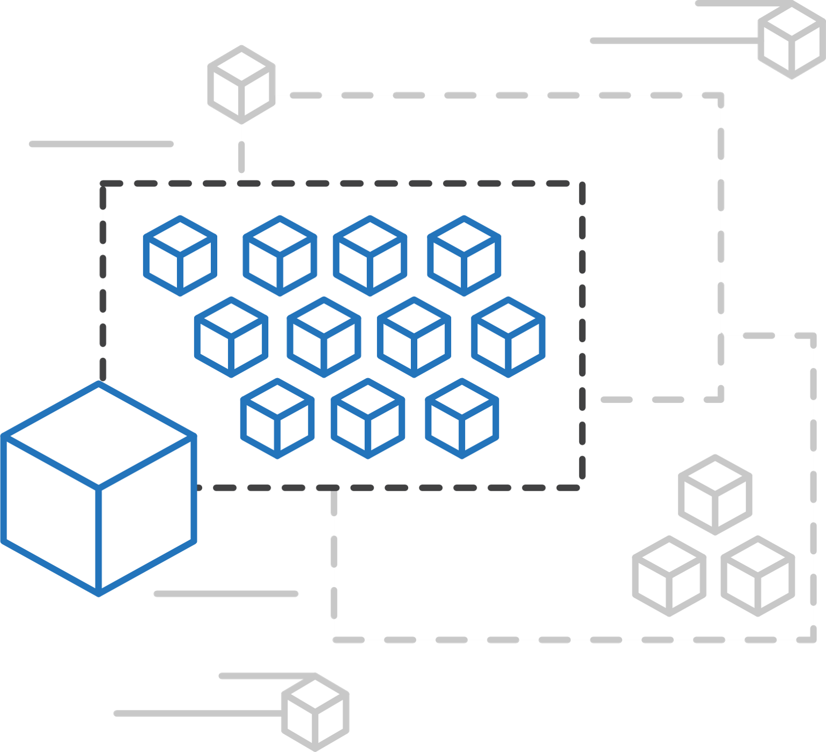
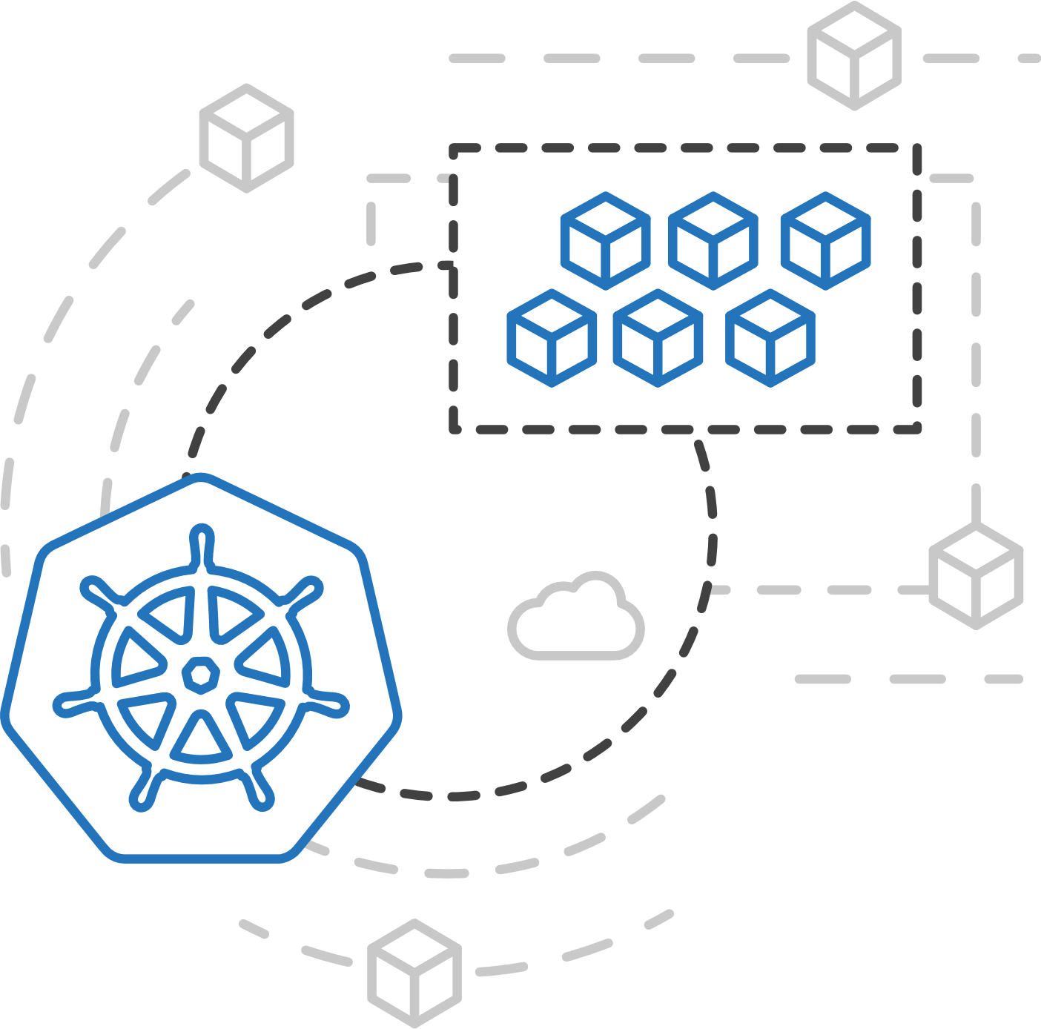
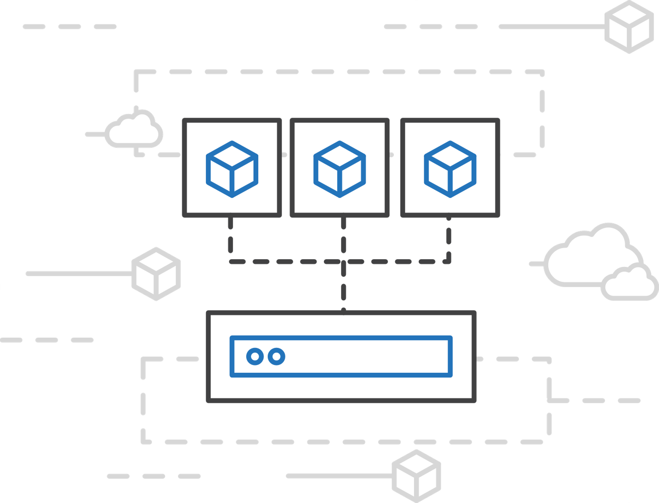
Azure Container Instances (ACI)
Easily run serverless containers
Run containers without managing servers
Containers as a primitive billed per second
Secure applications with hypervisor isolation

Slide 48
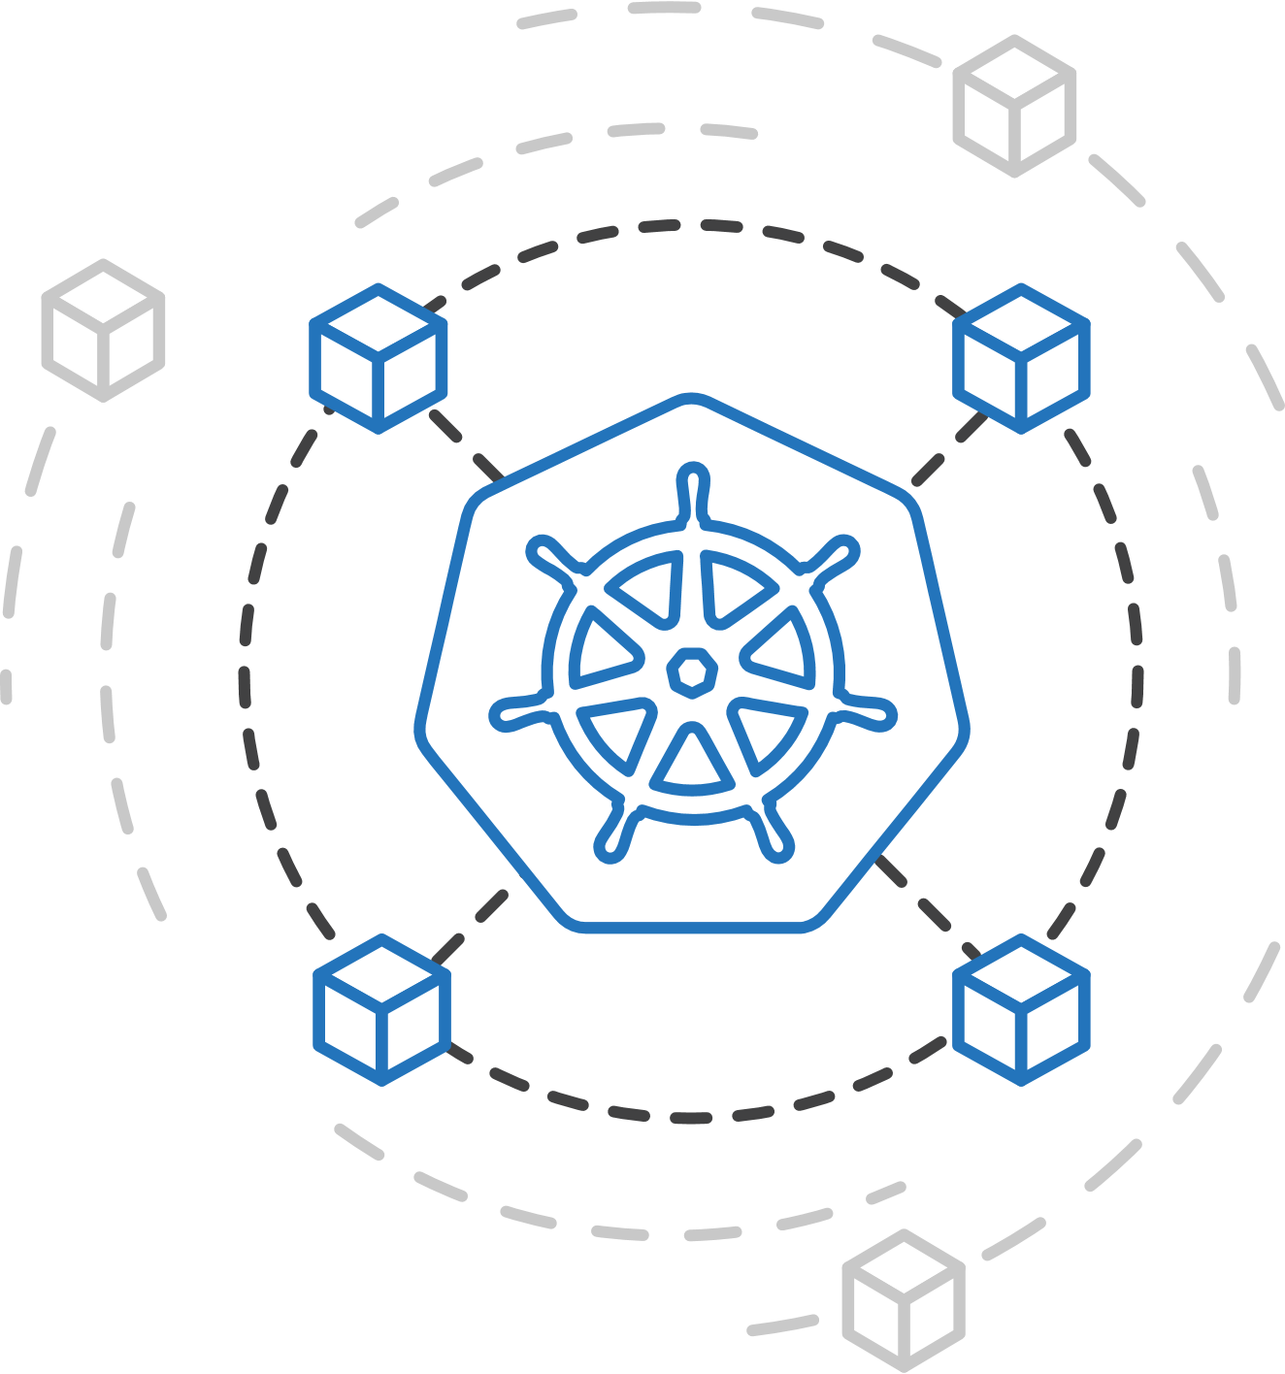
ACI Connector for Kubernetes
aka “Virtual Kubelet”
Kubernetes provides rich orchestration capabilities
ACI provides infinite container-based scale
The ACI Connector for K8s brings them together

Slide 49



Azure Kubernetes Service (AKS)
Azure Batch
Run repetitive compute jobs using containers
App Service
Azure Container Instances (ACI)
Enable applications and algorithms to easily and efficiently run in parallel at scale.
Run Batch tasks without having to manage an environment and dependencies.
Package, execute, and scale your High Performance Computing applications and batch workloads in a consistent, reproducible manner.
Service Fabric
Azure Batch
Azure Container Registry (ACR)

